Slide 1


Department of Information Science and Engineering
DEPARTMENT OF INFORMATION SCIENCE AND ENGINEERING
PROJECT PHASE 3
AIRFARE PRICE PREDICTION
PRESENTED BY
BATCH 41
1NT19IS109 – PIYUSH GEETESH
1NT19IS194 – AYUSH
1NT19IS122 – RAGHUNATHAN R
1NT19IS073 – KSHITIZ KUMAR
GUIDE NAME AND DESIGNATION
Ms. SNEHA HR, Assistant Professor
18-04-2023

Slide 2
Content
Introduction
Problem Statement
Objectives
Literature Survey
Outcome of Literature Survey
Methodology
Implementation
References

Slide 3
Abstract
The project aims to develop a hybrid approach that combines multiple machine learning models to enhance flight price prediction accuracy. It will be a significant contribution to the field of flight price prediction and has the potential to benefit both travelers and airlines alike. The presentation will provide an overview of the project objectives, methodology, results, and future directions.

Slide 4
Introduction
Developing an application for predicting flight prices using machine learning models.
Airlines maintain competitive relationships and dynamically change prices based on various factors.
Factors considered for pricing include financial, marketing, commercial, and social aspects.
Airline companies aim to maximize profits, while customers seek the best purchase deals.

Slide 5
Problem Statement
Developing a machine learning-based model for predicting the optimal airfare price at a given time slot.

Slide 6
Objectives
Providing customers with air tickets at the optimal price.
Evaluating and comparing the performance of different algorithms to identify the best-performing one for accurate airfare price prediction.

Slide 7
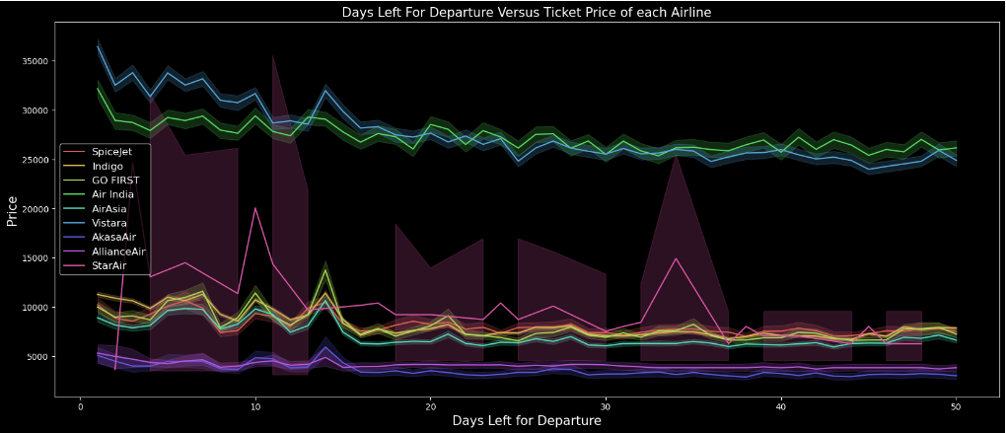
Analysis of Flight Prices

Slide 8
Literature Brief
Author | Title | Findings | Drawbacks
Groves and Gini | A Regression model for predicting optimal purchase timing for airline tickets. | Implemented the Pseudo-maximum likelihood (PSL) regression model. PSL regression works by estimating the parameters of the model by minimizing the difference between the observed data and the expected values of the latent variables, given the model. | Doesn’t accurately capture the complex and dynamic nature of the market. Model relies on panel data, which can be difficult and time-consuming to collect and clean. Computationally intensive and not suitable for high-dimensional datasets
Papadakies | Predicting Airfare Price | Ripple Down Rule Learner to build decision trees. Predicts price based on the rules it has learned from the training data Model splits the data based on their factors, creating branches for each possible value until data can no longer be split. | Its sensitivity to the quality and representation of the data used to train. Limited to binary splits and are not suitable for continuous or multiclass data. Difficult to interpret and understand the predictions.

Slide 9
Literature Brief
Author | Title | Findings | Drawbacks
Tianyi Wang | A Framework for Airfare Price Prediction: A Machine Learning Approach. | Logistic regression to predict binary outcomes, if flight fair will be over or under certain price threshold, demand, competition, and the time of year. Support vector machines (SVMs) used for finding the hyperplane that maximally separates different classes or values. | Logistic regression is limited to binary outcomes and is not suitable for continuous data. SVMs are not suitable for large or high-dimensional datasets.
Janssen | A Linear Quantile Mixed Regression Model for Prediction of Airline Ticket Prices. | Linear Quantile mixed Regression which was used to predict the fare for a particular flight at different quantiles of the fare distribution. Used for understanding the range of possible fares for a particular flight and the likelihood of different fares occurring. | Model was only able to perform well if the interval between now and the date of departure was large.

Slide 10
Literature Brief
Author | Title | Findings | Drawbacks
Ren , Yang and Yuan | Prediction of Airline Ticket Price | They studied the linear regression model and the outputs the model would predict. The predicted prices were observers and studied based on the estimated parameters and the input data that was used for different predictions. | Only able to capture relations described by a straight line. Unable to predict complex relations. Outliers have a large impact on the results. There can be small number of flights prices that are significantly higher or lower than the other flights.

Slide 11
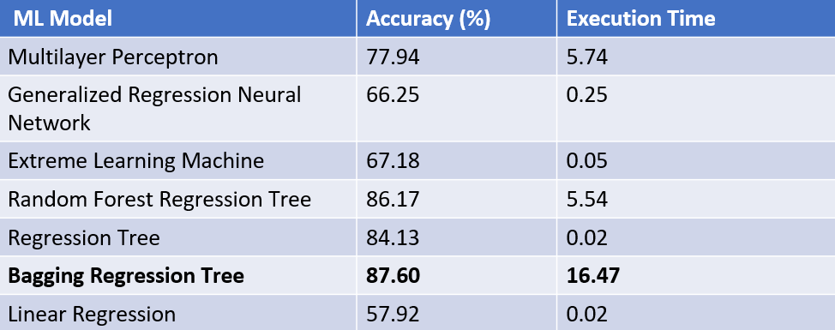
Outcomes of Survey

Slide 12
Outcomes of Survey
Bagging Regression Tree outperforms everyone in terms of accuracy and prediction.
Features selected for the same :
1. Departure time
2. Arrival time
3. Number of free luggage
4. Number of intermediate stops
5. Days left until departure

Slide 13
Research Gap
Feature selection
Some important factors and features could be missed that gives us more insightful conclusions
Dynamic Prediction
With time airlines have started using various other factors to provide flight fares catered to wide range of customers.
Factors such as frequent travelers, business class and social scores can have an impact on their flight fares
Time Interval Section
The price variations during seasonal or public events, festive seasons are not taken into consideration.

Slide 14
Motivation
Improve customer experience
Enhance decision making
Comparative analysis of algorithms
Feature selection for improved performance
Identify best-performing approach
Advance field of machine learning in airfare pricing.

Slide 15
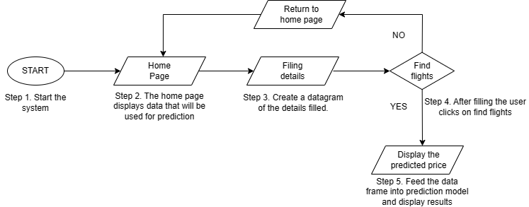
Implementation

Slide 16
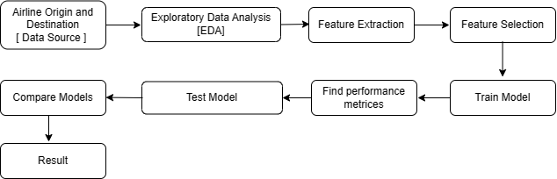
Framework

Slide 17
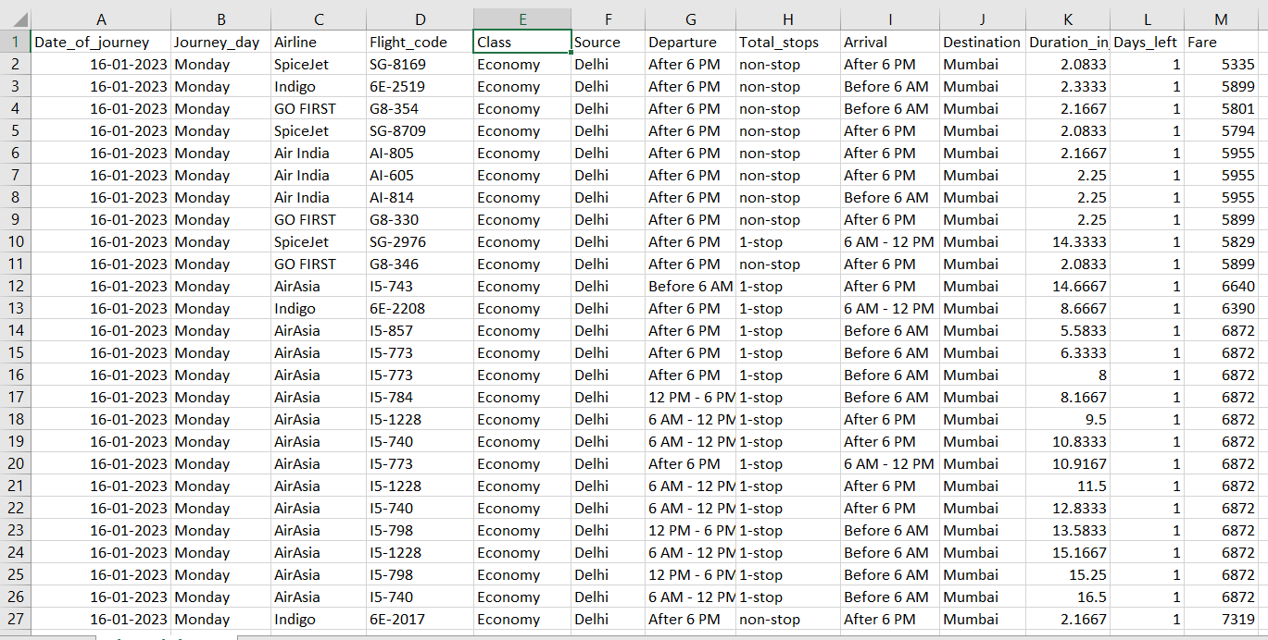
Methodology
Data Collection

Slide 18
Model Selection
Random Forest
Handling multiple features: Random Forest can handle a large number of features in flight data, such as departure time, arrival time, number of stops, duration, airline, and more, to accurately predict flight fares.
Capturing complex interactions: Random Forest can capture complex interactions and non-linear relationships between features, allowing it to identify patterns in flight data, such as peak travel times.
Fast training and prediction times: Random Forest has relatively fast training times, making it suitable for real-time or near real-time prediction of flight fares, which can be useful for dynamic pricing strategies by airlines.
Availability in popular libraries: Random Forest is widely available in popular machine learning libraries such as scikit-learn, making it easy to implement and deploy in a machine learning project for flight fare prediction.

Slide 19
Model Selection
Linear Regressor
Simplicity: Linear regression is a simple model that is easy to implement and interpret, making it suitable for quick and efficient predictions of flight prices.
Speed: Linear regression is a fast model that can quickly process large datasets, making it suitable for real-time or near real-time flight fare prediction applications.
Baseline model: Linear regression can serve as a baseline model for comparison with other more complex algorithms, helping to evaluate the performance of other models in the context of flight fare prediction.
Decision-making insights: Linear regression can provide insights into the factors that impact flight fares, aiding in decision-making for pricing strategies, revenue management, and customer targeting in the airline industry.
Notes:
Linear regression can still provide some useful information about the data, even in cases where the relationship between the input features and the target variable is not strictly linear. In the case of voting regression, the linear regression model is combined with other non-linear models, such as random forest regressor and gradient boosting regressor, to provide an ensemble prediction that can be more accurate than any individual model on its own.
The linear regression model may capture some important trends or relationships in the data that are not fully captured by the non-linear models. It may also help to reduce the risk of overfitting, as the linear regression model is less complex than the other models and has a lower risk of fitting noise in the data.
In summary, the use of linear regression in voting regression can be seen as a way to diversify the models used in the ensemble, and to potentially capture important information that may not be captured by the other models alone.

Slide 20
Model Selection
Gradient Boosting
High accuracy: Gradient boosting algorithms are known for their ability to achieve high accuracy in predicting flight fares due to their iterative optimization process.
Flexibility: Gradient boosting can handle diverse types of features, including categorical and numerical, making it adaptable to various data types commonly encountered in flight fare prediction.
Feature importance: Gradient boosting provides insights into feature importance, allowing for identification of influential features in predicting flight fares and understanding underlying factors impacting prices.
Scalability: Gradient boosting algorithms can efficiently process large datasets, making them suitable for handling the high volume and velocity of data in the airline industry.
Notes:
What is Gradient Boosting ?
Gradient Boosting is a machine learning algorithm that is used for both regression and classification tasks. It is an ensemble learning technique that builds a series of weak models, which are typically decision trees, and then combines them to create a strong predictive model.
The algorithm works by iteratively improving the weak models to minimize the error of the overall model. In each iteration, the algorithm creates a new model that focuses on the error of the previous model by adding new trees that attempt to correct the errors of the previous ones.
The name "gradient boosting" comes from the use of gradient descent to minimize the loss function of the model. The loss function is the measure of the error of the model on the training data, and gradient descent is used to find the direction of steepest descent, or the direction that will minimize the loss function the most.
The main advantage of gradient boosting is its ability to handle non-linear and non-monotonic relationships between the input and output variables. Additionally, it can handle missing data, and it is relatively robust to outliers. However, it can be computationally expensive and requires careful tuning of the hyperparameters to achieve good results.

Slide 21
Model Selection
Voting Regression
Ensemble of diverse models: Voting regression with linear regression, random forest, and gradient boosting combines different models for improved prediction accuracy in flight fare prediction.
Increased accuracy: Ensemble of multiple models results in more accurate and reliable flight fare predictions through averaging or combining model predictions.
Model diversity: Linear regression, random forest, and gradient boosting capture different aspects of flight fare patterns, providing complementary perspectives for improved predictions.
Flexibility: Voting regression allows for easy integration of different models, making it flexible to incorporate other relevant techniques as needed for flight fare prediction tasks.
Scalability: Linear regression, random forest, and gradient boosting are scalable and can handle large datasets, suitable for processing high volume and velocity of data in flight fare prediction.

Slide 22
Conclusion
In this project we used machine learning models to find the optimal ticket price.
We acknowledge that these factors are dynamic and require frequent updates to ensure accurate results.
While achieving 100% accuracy in airfare prediction may be challenging, we aim to leverage machine learning techniques and innovative approaches to improve prediction accuracy.
Our research endeavors to provide the best possible results to assist customers in making informed decisions about airfare booking.

Slide 23
References
Airfare Prices Prediction Using Machine Learning Techniques K. Tziridis, Th. Kalampokas, G.A. Papakostas HUMAIN-Lab. Department of Computer and Informatics Engineering Eastern Macedonia and Thrace Institute of Technology Kavala, Greece.K.I. Diamantaras. Department of Information Technology TEI of Thessaloniki Sindos, Greece . 10.23919/EUSIPCO.2017.8081365
OTPS: A Decision Support Service for Optimal Airfare Ticket Purchase Yuchang Xu, Jian Cao*. Shanghai Institute for Advanced Communication and Data Science. Dept. of Computer Science& Engineering. Shanghai Jiao Tong University. Shanghai, China
ACER:An Adaptive Context-Aware Ensemble Regression Model for Airfare Price Prediction. Tao Liu, Jian Cao. Department of Computer Science and Engineering. Shanghai Jiao Tong University, Shanghai 200240, China.Yudong Tan, Quanwu Xiao Air Ticketing B.U., Ctrip.com International Ltd, Shanghai 200335, China.
A Framework for Airfare Price Prediction: A Machine Learning Approach.Tianyi Wang∗, Samira Pouyanfar∗, Haiman Tian∗, Yudong Tao†,Miguel Alonso Jr.∗, Steven Luis∗ and Shu-Ching Chen∗School of Computing and Information Sciences.Florida International University, Miami, Florida 33199.
An Ensemble Learning Based Approach For Building Airfare Forecast Service. Yuwen Chen. Shanghai Jiao Tong University. Shanghai, China. Jian Cao∗.Shanghai Jiao Tong University. Shanghai, China. Shanshan Feng. Shanghai Jiao Tong University. Shanghai, China.Yudong Tan. Ctrip.com. Shanghai, China.
An Airfare Prediction Model for Developing Markets Viet Hoang Vu, Quang Tran Minh Faculty of Computer Science and Engineering Ho Chi Minh City University of Technology, VNU - HCM Ho Chi Minh City, Viet Nam Email: {7140266, quangtran}@hcmut.edu.vn Phu H. Phung Intelligent Systems Security Lab Department of Computer Science University of Dayton, Dayton, OH, USA WWW: http://academic.udayton.edu/PhuPhung/

Slide 24

THANK YOU

